Slide 1


Slide 2
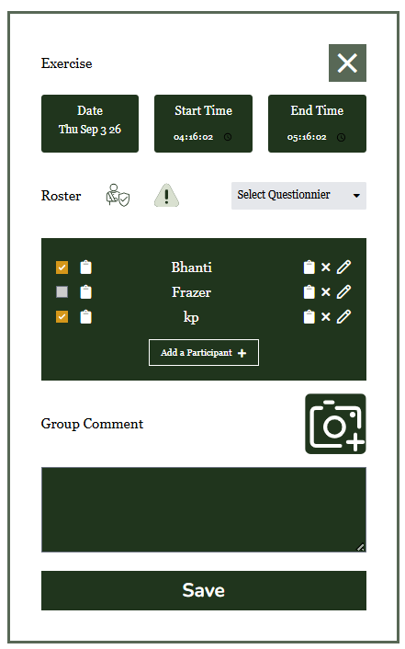
Maryan’s Park- Front Garden
[] weed [] water [] bed
Write comment

Slide 3
Maryan’s Park- Front Garden
[] weed [] water [] bed
Write comment

