Slide 1
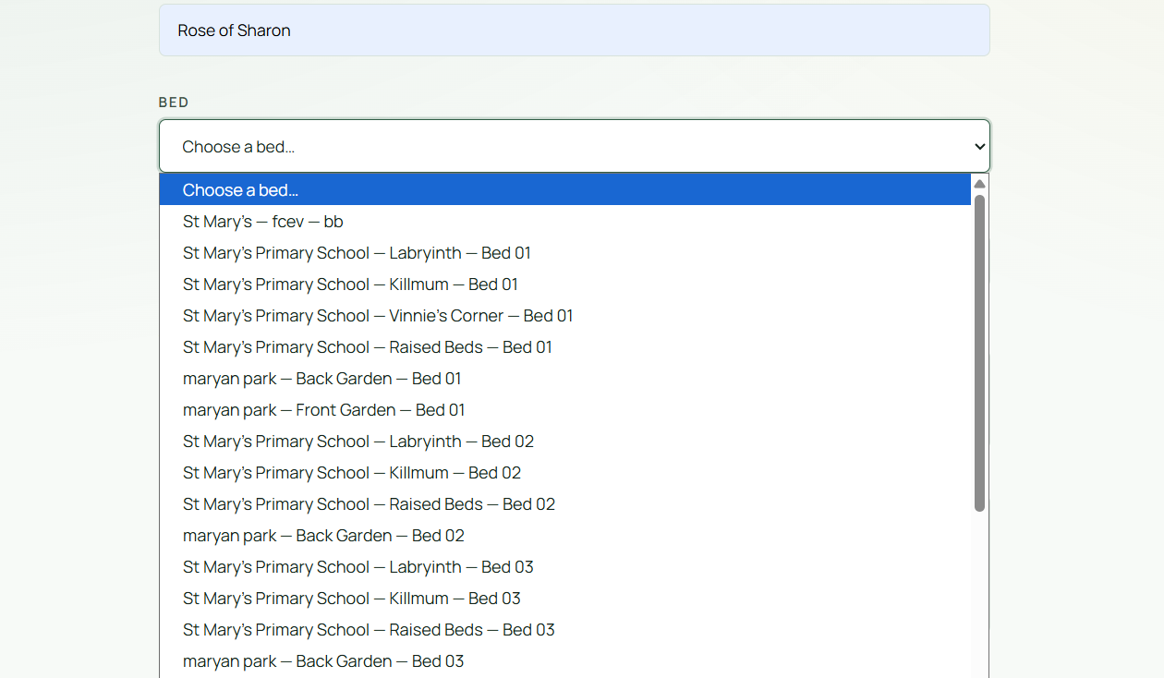
Typable
Alphabetical
order

